Slide 1
HOME BUDGET
EXPENSE TRACKER AND
ANALYSIS SYSTEM
Project Presentation
Team Contributions • Features • Implementation • Outcomes
2026

Slide 2
Project Overview
A web-based application for recording, organizing and understanding personal finances.
Purpose
Core Features
Project Outcome
Help users record income and expenses, monitor budgets, and understand spending patterns.
Income and expense tracking, transaction history, monthly budgets, summaries and visual reports.
A connected application that brings together the website, backend services, database and analysis.
Main workflow
User enters
transactions
Flask processes
requests
MySQL stores
data
Analysis creates
summaries & charts
→
→
→
HOME BUDGET • EXPENSE TRACKER AND ANALYSIS SYSTEM
02

Slide 3
Team Contributions
Five members with clearly separated responsibilities.
Zaddu Lakshmi Sai Charitha
Santhosh Boya
Peetha Geethika
Frontend Developer
Backend Developer
Database Management
Website design, pages, forms and responsive user experience.
Flask routes, application logic, validation and server-side operations.
MySQL database structure, tables, data organization and database consistency.
Eniya J.
Thoka Brahmeswari
Data Analysis & Visualization
Integration & Testing
Financial calculations, spending analysis, charts and CSV reports.
Module integration, end-to-end testing, error fixing and documentation.
HOME BUDGET • EXPENSE TRACKER AND ANALYSIS SYSTEM
03

Slide 4
Technology Stack
Tools used across the different project modules.
Frontend
Backend
HTML • CSS • JavaScript • Bootstrap
Builds the screens and user interactions.
Python • Flask
Handles requests, routes and application logic.
Database
Analysis
MySQL • MySQL Workbench
Stores user, income, expense and budget information.
Python • Pandas • NumPy • Plotly
Processes financial records and generates visual insights.
HOME BUDGET • EXPENSE TRACKER AND ANALYSIS SYSTEM
04

Slide 5
Database Management
Peetha Geethika • Database Management
Organized the MySQL database structure for the home budget application.
Created and maintained tables for income, expenses and budgets.
Defined appropriate fields and relationships to keep financial records organized.
Used MySQL Workbench to inspect and manage database tables.
Supported reliable storage and retrieval of transaction and budget information.
Module responsibility
Focus: data structure, storage, organization and consistency.
Backend connection code and Flask request handling are assigned to the Backend Developer.
HOME BUDGET • EXPENSE TRACKER AND ANALYSIS SYSTEM
05

Slide 6
Backend Development
Santhosh Boya • Backend Developer
Developed server-side functionality using Python and Flask.
Created Flask routes to handle income, expense and budget operations.
Implemented CRUD operations: add, view, edit and delete records.
Connected application logic to the MySQL database.
Added input validation and database error handling.
Tested backend endpoints and resolved server-side issues.
Backend outcome
A server-side layer that receives website requests, processes application logic and communicates with the database.
HOME BUDGET • EXPENSE TRACKER AND ANALYSIS SYSTEM
06

Slide 7
Frontend Development
Zaddu Lakshmi Sai Charitha • Frontend Developer
Designed the website dashboard layout and navigation menu.
Created income and expense entry forms and a transaction history table.
Developed dashboard cards to display total income, expenses and balance.
Connected website forms and actions with the Flask routes.
Added monthly filters and responsive styling for different screen sizes.
Improved page colors, spacing and navigation for a clear user experience.
Checked form behavior and navigation across the website.
Frontend outcome
A user-friendly and responsive website that allows users to enter transactions, navigate features and view financial summaries.
Your assigned module
HOME BUDGET • EXPENSE TRACKER AND ANALYSIS SYSTEM
07

Slide 8
Data Analysis & Visualization
Eniya J. • Data Analysis and Visualization
Prepared income and expense data for analysis.
Calculated total income, total expenses, balance and savings rate.
Performed category-wise and monthly financial analysis using Pandas and NumPy.
Created category-wise pie charts and monthly bar and line charts using Plotly.
Added warnings when spending exceeds the allocated budget.
Verified calculations and charts using database records.
Implemented CSV export for financial summaries.
Analysis outcome
Interactive visualizations and downloadable reports help users understand spending patterns and monitor their budget.
HOME BUDGET • EXPENSE TRACKER AND ANALYSIS SYSTEM
08

Slide 9
Integration & Testing
Thoka Brahmeswari • Integration and Testing
Organized the project structure and coordinated module requirements.
Aligned function names and Flask routes across team modules.
Integrated the frontend, backend, database and analysis components.
Connected budget warnings, CSV downloads and dashboard filters.
Tested add, edit, delete, calculations, charts and budget alerts.
Identified and fixed integration issues and verified the complete application.
Prepared project documentation, screenshots and presentation materials.
Testing outcome
The modules work together as one application, with key user flows and financial features checked.
HOME BUDGET • EXPENSE TRACKER AND ANALYSIS SYSTEM
09

Slide 10
PROJECT OUTCOME
A unified home budget
management system
Track
Income & expenses
Plan
The project combines transaction entry, secure data organization, server-side processing and financial analysis in one application.
Monthly budgets
Understand
Charts & reports
THANK YOU

Slide 11
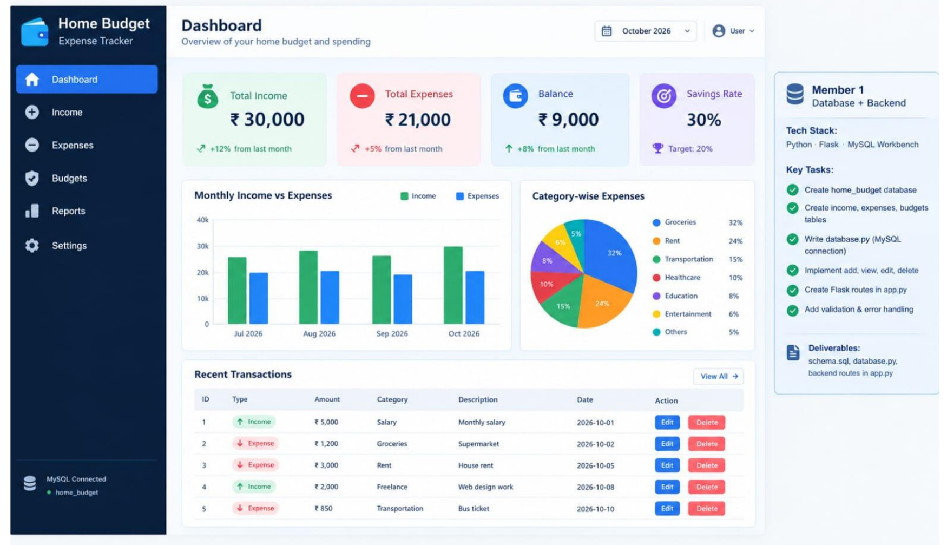
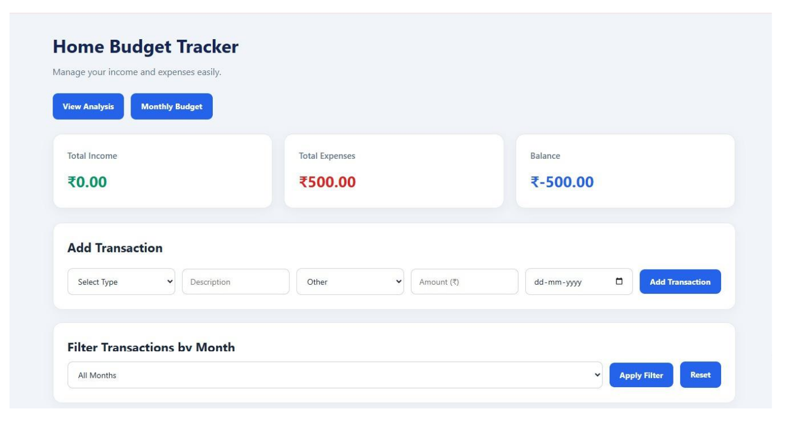
Project Screenshots – Dashboard & Tracker
Actual application screens captured from the project documentation you shared.
Dashboard overview – summary cards, charts and recent transactions
Tracker – income, expenses and monthly filters
HOME BUDGET • EXPENSE TRACKER AND ANALYSIS SYSTEM
11

Slide 12
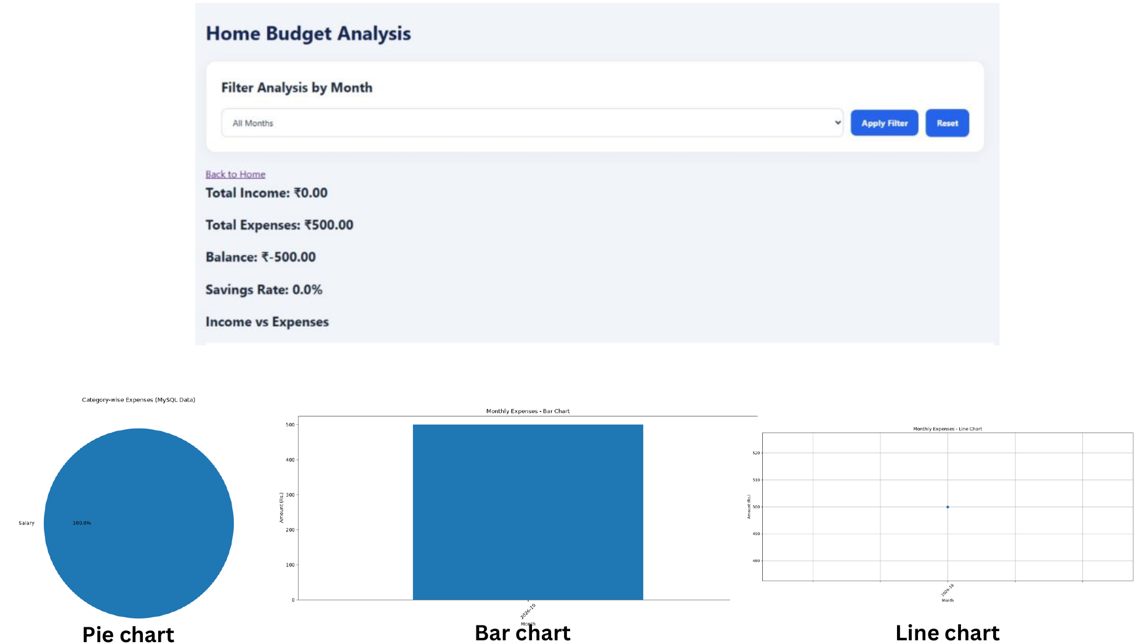
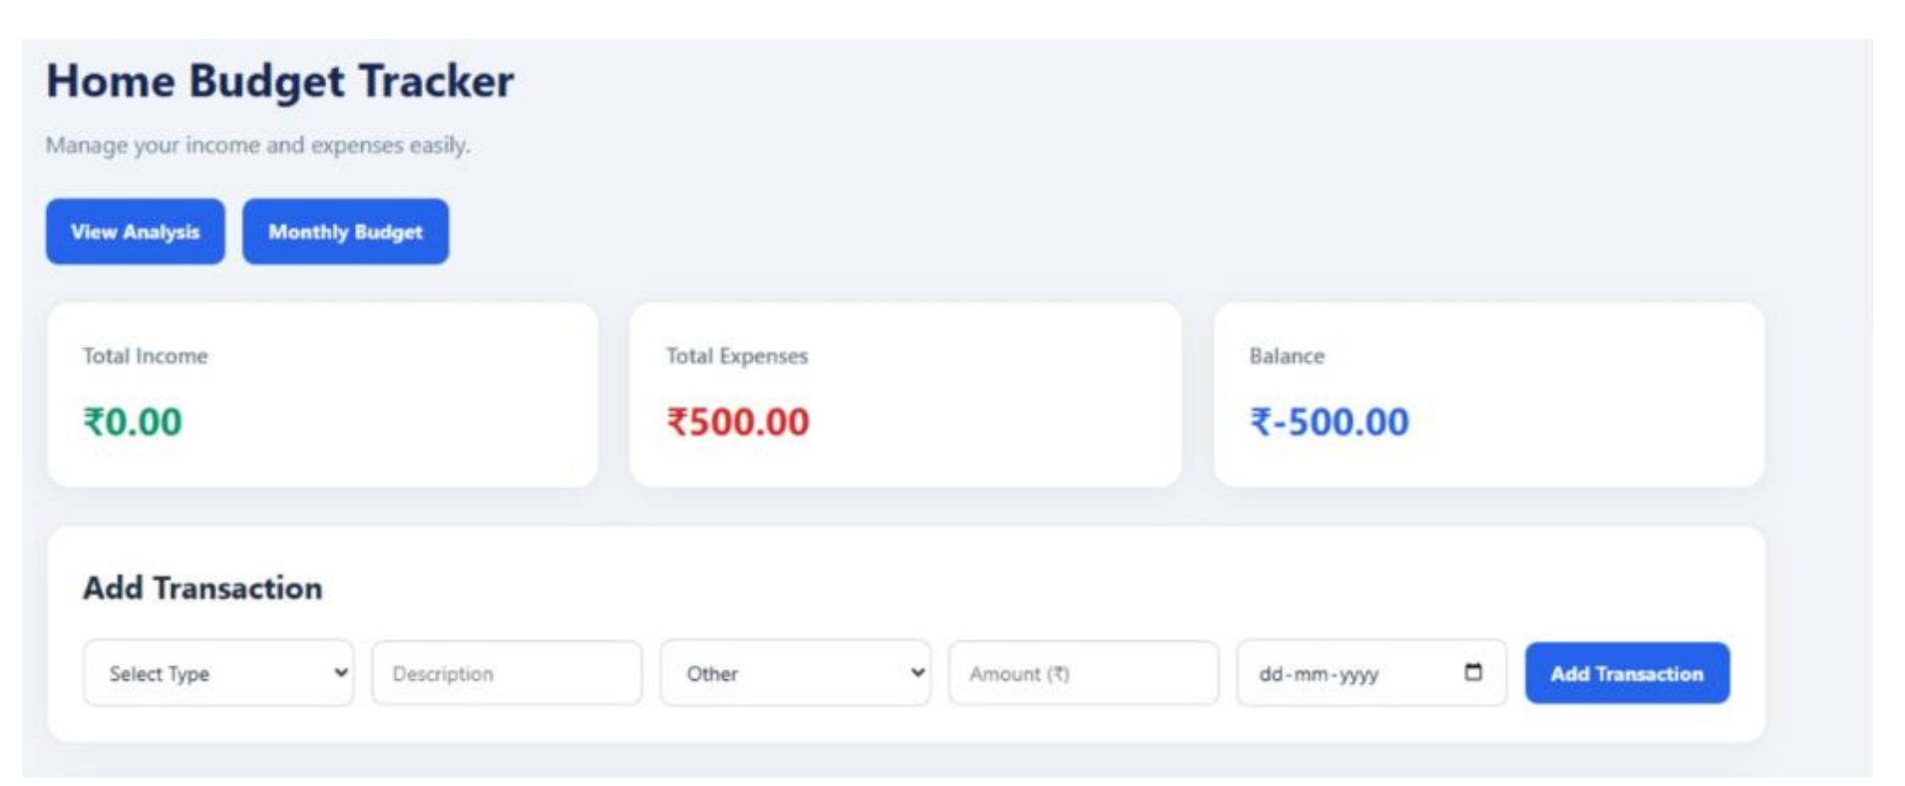
Project Screenshots – Analysis & Transaction Entry
Actual analysis and transaction-entry screens from your supplied project PDF.
Analysis page – financial summary and pie, bar and line charts
Transaction entry – add income or expense records
HOME BUDGET • EXPENSE TRACKER AND ANALYSIS SYSTEM
12

